Slide 1


Design and Performance Analysis of Solar PV system using PV-syst
It shines on us too and helps us all grow.
Indrajeet Date (21129408)

Slide 2


CONTENT
INTRODUCTION
STEPS IN ANALYSIS
TYPES OF LOSSES
RESULTS
CONCLUSION
REFERENCES

Slide 3
INTRODUCTION
What is PVsyst Software
One of the oldest software, developed by University of Geneva.
Main features:
Meteorological data analysis
Complete database of PV Module, Inverter, & Meteo data.
Import of solar radiation data from SolarGIS, Meteonorm, NASA-SSE and many more.
Also import files as .PAN files, .OND files, ,BAT files.
Shadow analysis using 3D models.
Design simulation of Grid connected, Standalone system.
Economic Evaluation.

Slide 4
STEPS IN ANALYSIS
Selection of PV module & Inverter
Location
Import Meteo data
Orientation
System design
Module Quality loss/Mismatch loss/Soiling loss
Simulation execution
Shading Analysis
Location (geographical detail)
Coordinates: Latitude & Longitude (26.51014267,80.23582628,157)
Address: Department of Sustainable Energy Engineering.
Import Meteo data
Used Meteonorm8.1 data for analysis from (1996 − 2015)

Slide 5
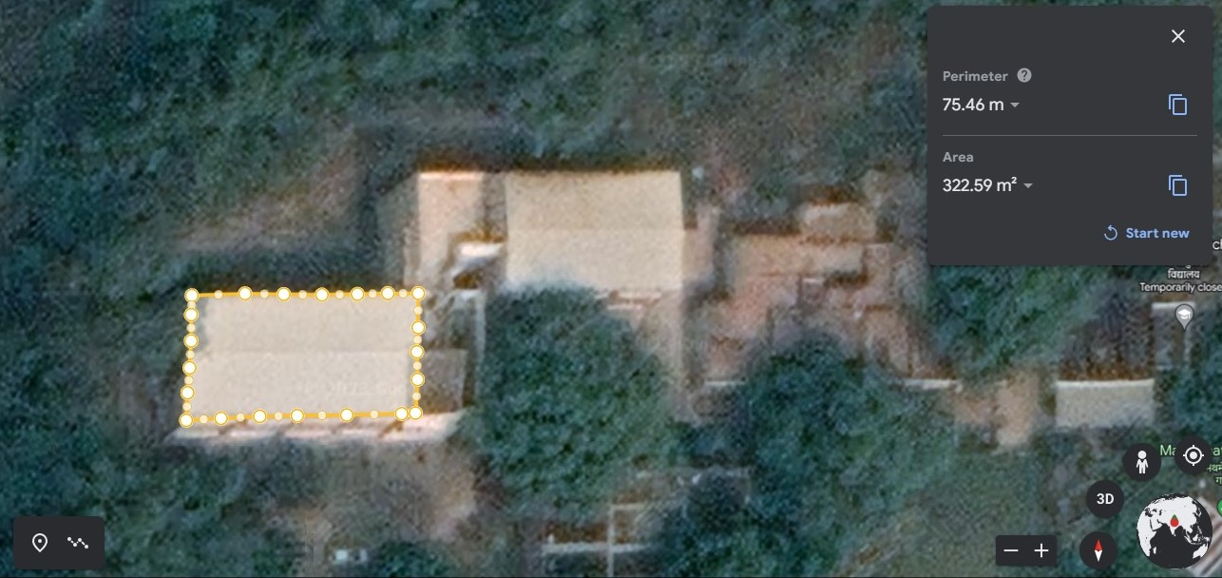
STEPS IN ANALYSIS

Slide 6
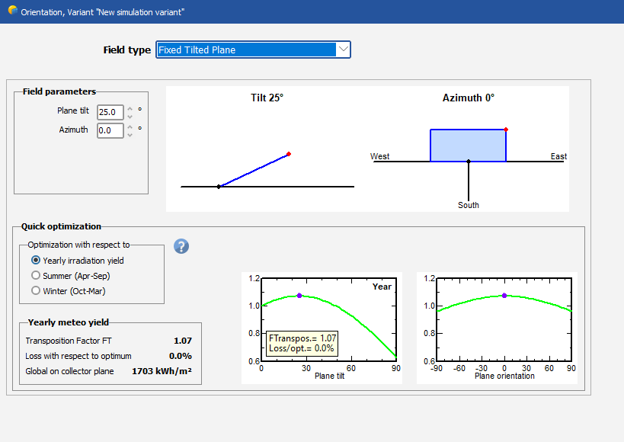
STEPS IN ANALYSIS
3) Orientation
In orientation part the field parameters includes azimuth angle, tilt angle.
Quick optimization tools:
Yearly irradiance yield
Summer (Apr- Sep)
Winter (Oct-Mar)

Slide 7
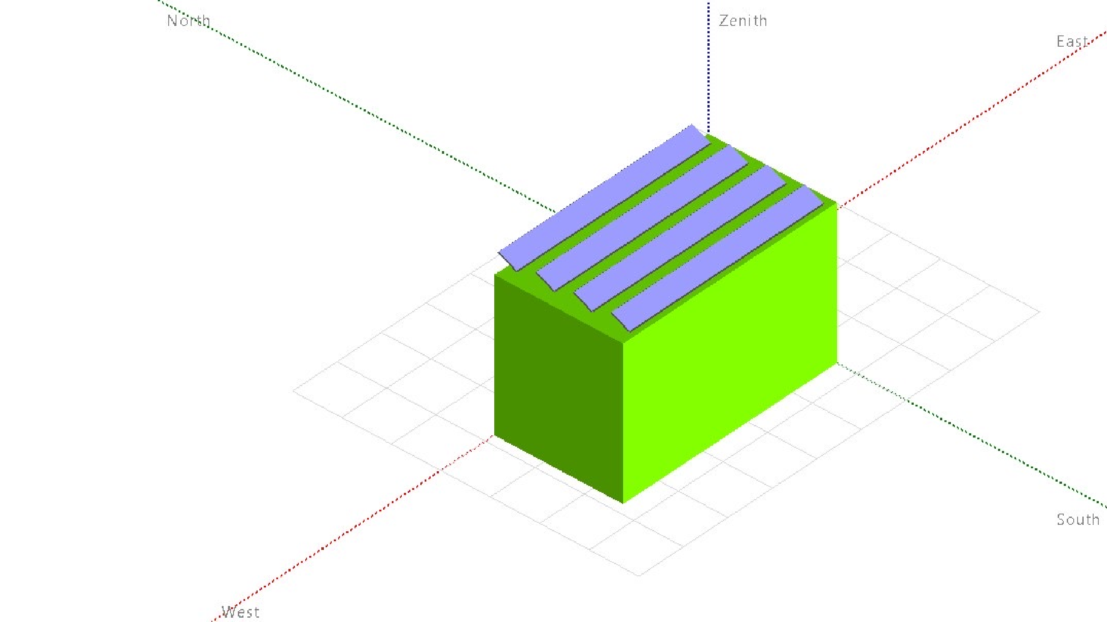
4) System design
Department of Sustainable Energy Engineering

Slide 8
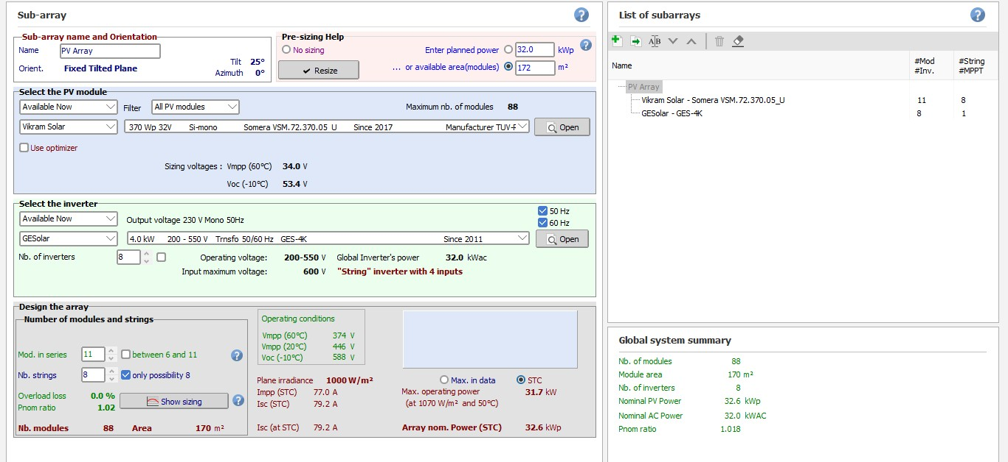
STEPS IN ANALYSIS
5) Selection of PV module & Inverter

Slide 9
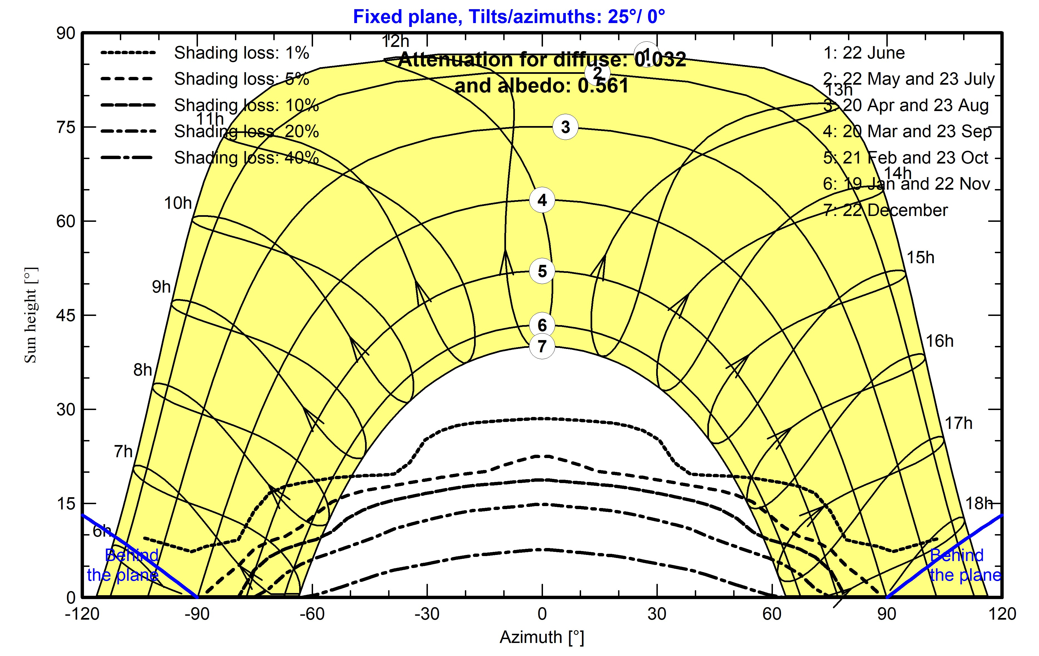
STEPS IN ANALYSIS
6) Shading Analysis
Near Shading
Shading caused by objects that are close to the solar panel array, such as buildings, trees, or other objects.
Significant impact on the performance of a PV system.
It create "hot spots" on the solar panels and reduce the overall efficiency of the panel.

Slide 10
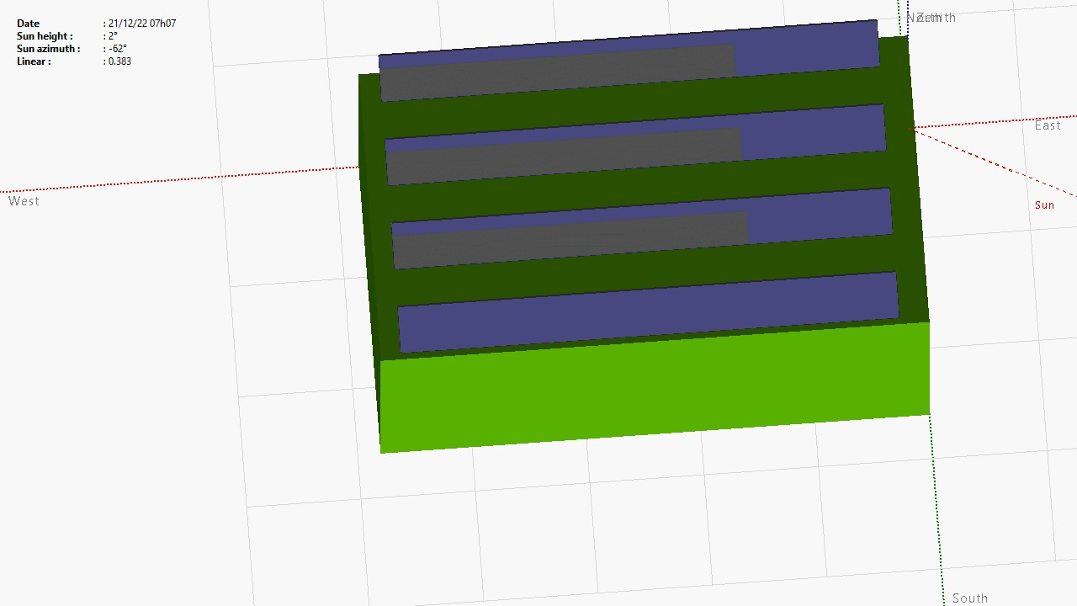

Slide 11
TYPES OF LOSSES
Temperature Losses
With the increase in temperature of PV module the efficiency decreases.
Reflection losses
Occur when sunlight reflects off the surface of a PV panel.
Wiring losses
The electrical wiring and connections cause losses due to resistance, which can reduce the overall efficiency of the system.
Mismatch losses
Mismatch losses occur when different PV panels in an array have different electrical characteristics
Ohmic/Resistive Losses
Occur when electrical current flows through the internal resistance of the panel's cells and interconnections (metal contacts and busbars used to interconnect the cells).

Slide 12
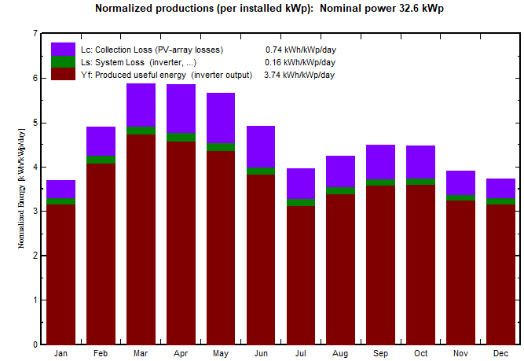
RESULTS
The normalized productions of each month has been stated, It gives the three important parameters:
Collection loss (PV-array losses):- Refers to the
energy lost in the PV module itself :- 0.74
𝑘𝖶#
𝑘𝖶𝑝%𝑑𝑎𝑦
System Loss:- Refers to the energy lost in the various components of the PV system outside of the PV module, such as the wiring, inverters, and
transformers :- 0.16
𝑘𝖶#
𝑘𝖶𝑝%𝑑𝑎𝑦
Produced useful energy (Inverter output):-
3.74
𝑘𝖶#
𝑘𝖶𝑝%𝑑𝑎𝑦

Slide 13
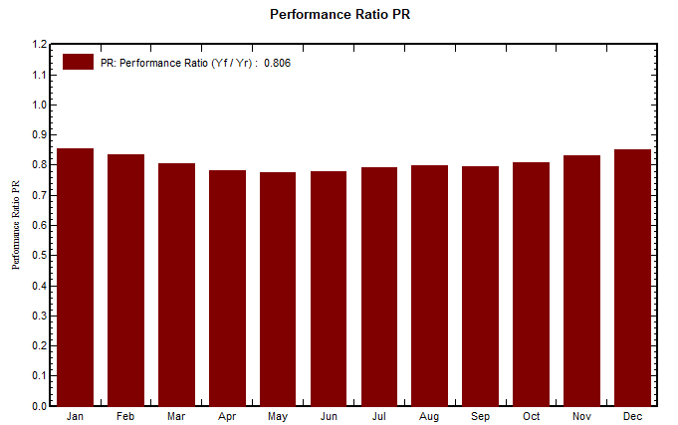
RESULTS
The performance ratio of each month has been stated.
It is a measure of the efficiency of a PV system.
𝑃𝑅 =
𝐸𝑛𝑒𝑟g𝑦_{𝑎𝑐𝑡$𝑎𝑙}
𝐸𝑛𝑒𝑟g𝑦_{&𝑑𝑒𝑎𝑙}
Optimal Range 0.7 − 0.9
Obtained Value of 0.806

Slide 14
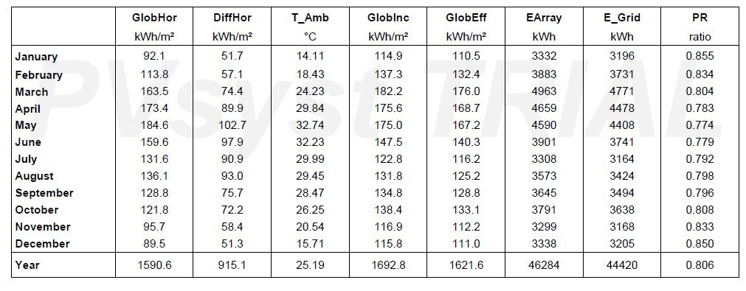
RESULTS
global horizontal irradiation, horizontal diffuse irradiation, ambient temperature, and global incident radiation. performance ratio, energy injected into Grid, effective energy at the output of the array

Slide 15
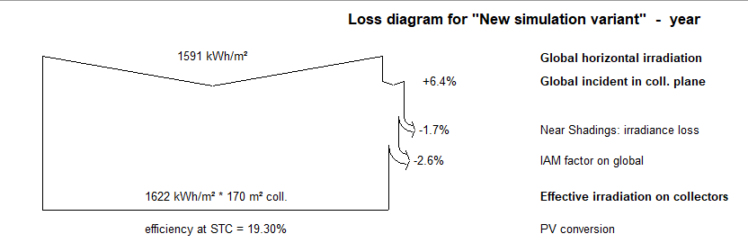
RESULTS
Loss diagram shows all the losses that occur in the system step by step.
1591 𝑘𝑊ℎ/𝑚² is falling in this region to the PV system.
Due to IAM losses and soiling losses the total energy generated in this system is
53.36 𝑀𝑊ℎ where the efficiency is 19.30% at STC.
Finally, 44.42 𝑀𝑊ℎ and the rest of energy is lost due to mismatch loss, inverter loss during operation and Ohmic loss.

Slide 16
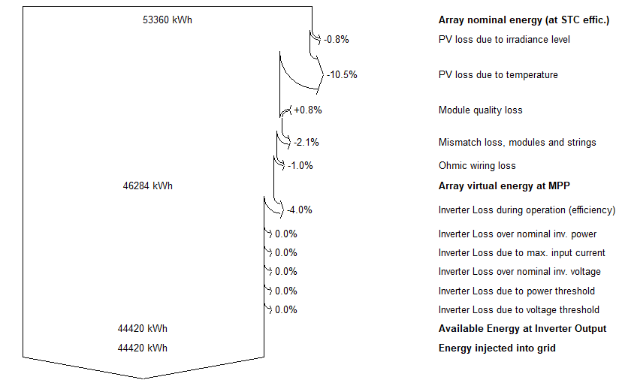
RESULTS
Finally, 44.42 𝑀𝑤ℎ and the rest of energy is lost due to mismatch loss, inverter loss during operation and Ohmic loss.

Slide 17
CONCLUSION
Design and performance analysis of grid-connected PV system in Department of Sustainable Energy Engineering at IIT Kanpur.
The system production is 44.42 ^{𝑀𝖶#} and the specific output is 1364
𝑘𝖶#
, the
𝑦𝑒𝑎𝑟
𝑘𝖶𝑝%𝑦𝑒𝑎𝑟
performance ratio is 0.8059, and the system losses is 0.16 ^{𝑘𝖶#} .
𝑘𝖶𝑝%𝑑𝑎𝑦
The software PV-syst examines any kind of losses.

Slide 18
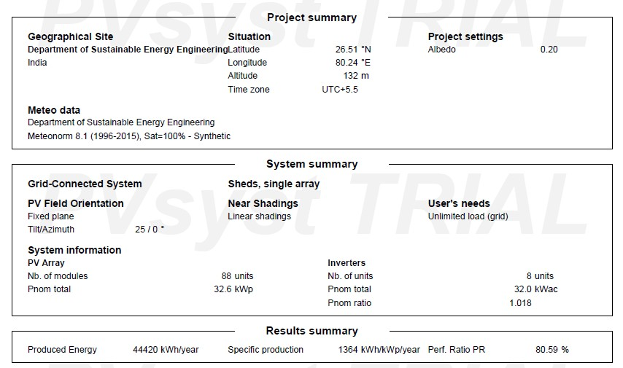
CONCLUSION

Slide 19
REFERENCES
https://www.google.com/intl/en_in/earth/
https://www.pvsyst.com/help/index.html?contents_table.htm
https://www.sciencedirect.com/science/article/pii/S2214785321058259?via%3Dihub

